Slide 1
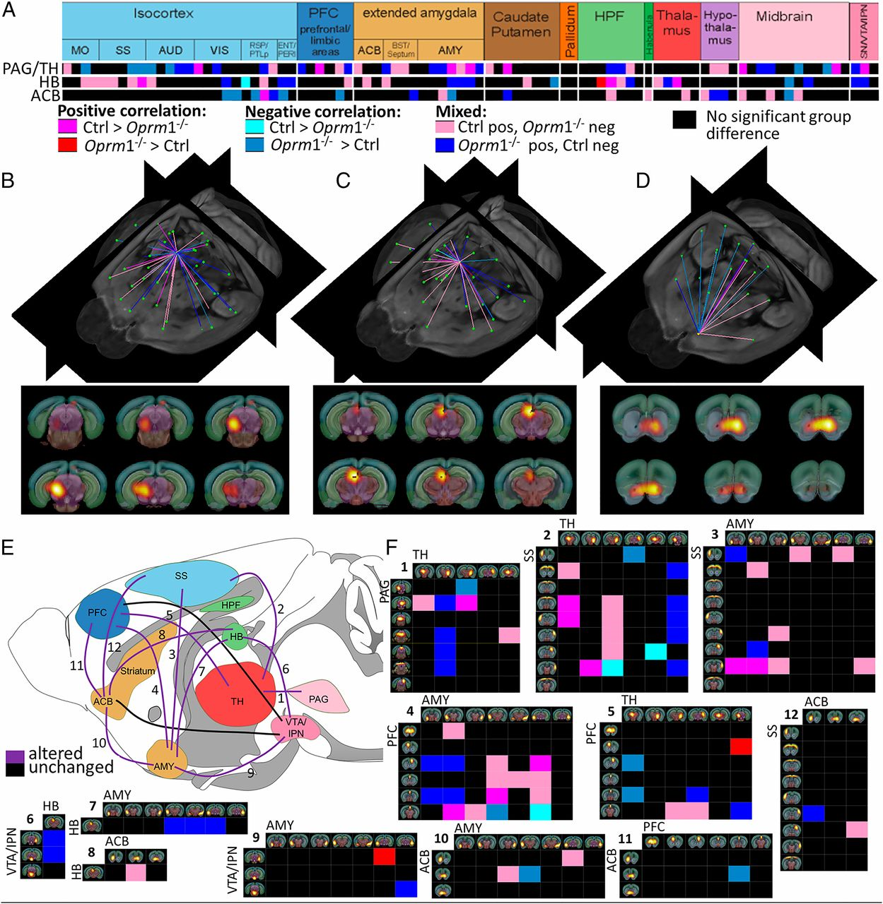
MOR deletion predominantly reshapes the RAC, with a major impact on aversion-related components.
Anna E. Mechling et al. PNAS 2016;113:11603-11608
©2016 by National Academy of Sciences
Notes:
MOR deletion predominantly reshapes the RAC, with a major impact on aversion-related components. (A) Detailed view into the matrix of significant connectivity alterations, corresponding to the three main nodes of RAC: PAG/TH (rank 1, see Fig 1D), HB (rank 10, see Fig 1D), and ACB (rank 37). Predominant alterations within reward/aversion pathways correlate with major behavioral modifications reported in mutant mice for pain, emotional, and reward-related behaviors (Dataset S1). (B–D) Three-dimensional display of significantly altered connections of functional nodes from A. The anatomical assignment corresponds to PAG/TH (B and Movie S1), pain/aversion component; HB (C and Movie S2), involved in both reward and aversion processing; and ACB (D and Movie S3), dominant role in reward processing. The three areas are also sites of high MOR density in the normal mouse brain. (E and F) Unified view of connectivity changes in the RAC circuity of live Oprm1^{−/−} brain. Key players of this circuitry are identified as follows: PFC, ACB, AMY, VTA/IPN, TH/PAG, HB, and SS (E). All modified connections are numbered and corresponding detailed connectivity patterns are provided in F. Functional pathways between two regions were considered altered when at least two functional nodes assigned to the respective anatomical areas change their direct connectional pattern.

